Slide 1

Eyes on the City: Leveraging Multi-View Face Detection for Proactive Security in Smart Cities
Media Engineering and Technology Faculty
Student
Abdelrhman Atef Yakout
Supervisor
Prof. Dr. Mohammed Abdel-Megeed Salem
Co-supervisors
Prof. Dr. Mohamed Abdel-Ghany
Eng. Yomna Islam Youssef
Bachelor thesis – Spring 2024
10/6/2024

Slide 2
Outline
Introduction
Problem statement
Related work
Proposed design
Implementation
Results
Conclusion
Future work

Slide 3
Introduction

Slide 4
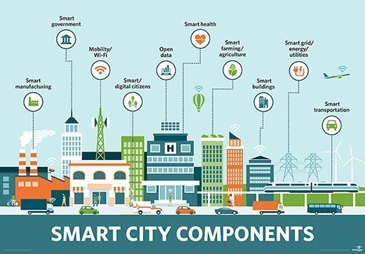
Introduction
Emergence of smart cities.
Better quality of life.
New job opportunities.
Smart traffic systems.

Slide 5
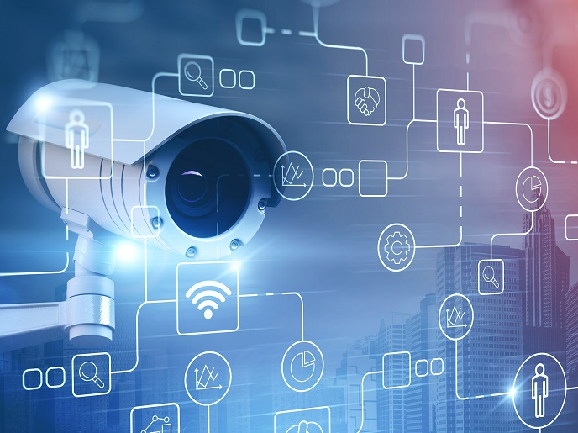
Introduction
Video surveillance applications in smart cities.
Importance of face detection and recognition in video surveillance systems.

Slide 6
Problem statement

Slide 7
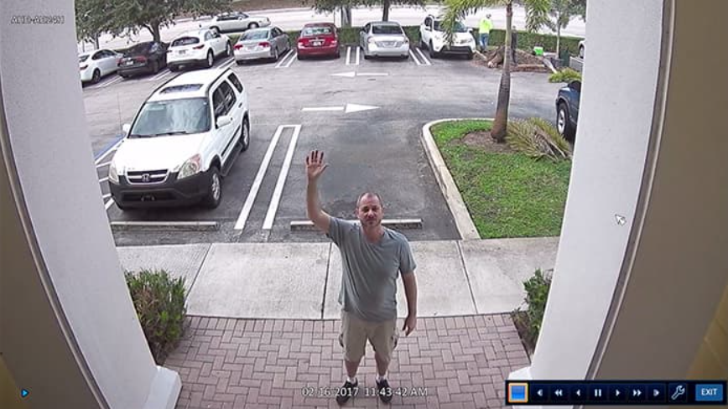
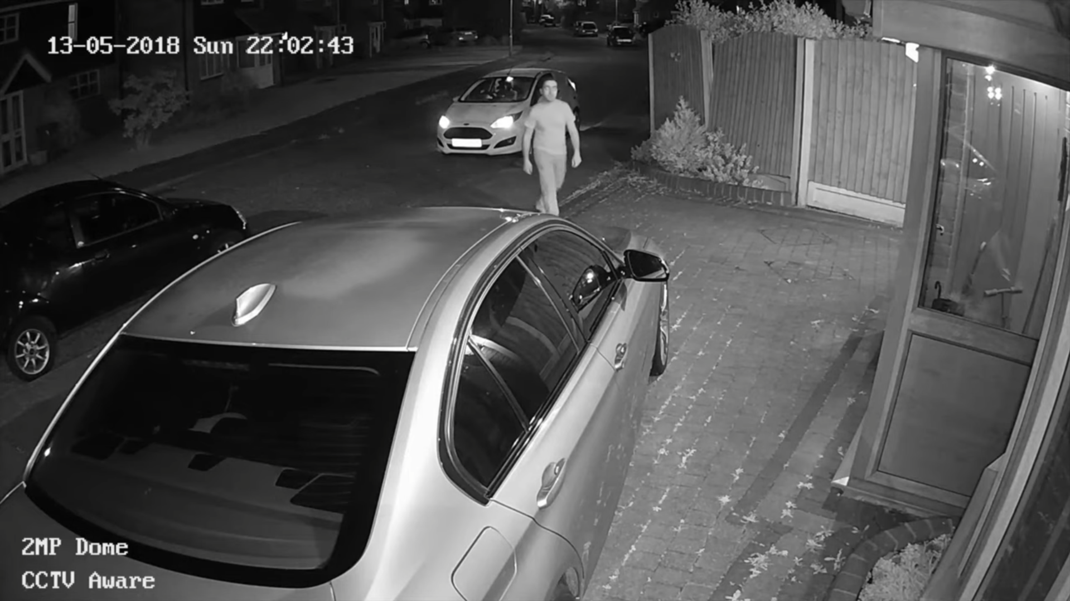
Problem statement
Video surveillance conditions.
Small face sizes and away from camera.
Pose Variation, occlusions and different lightning conditions.

Slide 8
Related work

Slide 9
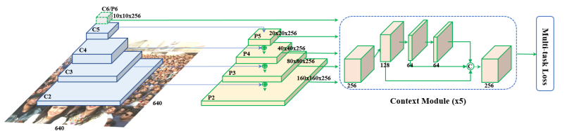
Related work
Face detection:
RetinaFace:
Has Multi-level pyramid feature.
Higher you go the smaller the faces extracted are.
An average precision of 96.1%.
[1]

Slide 10
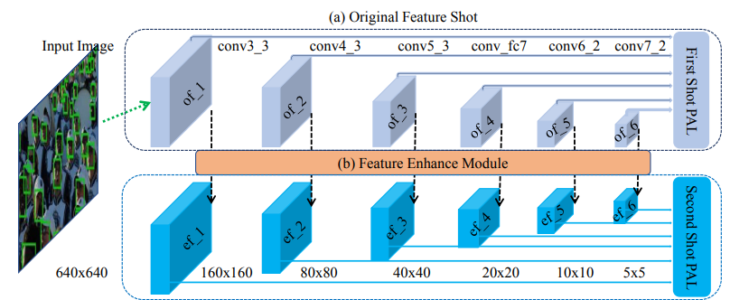
Related work
Dual Shot Face Detector (DSFD):
Similar to RetinaFace.
Each layer pass through feature enhancer module.
An average precision of 95.3%.
[2]

Slide 11
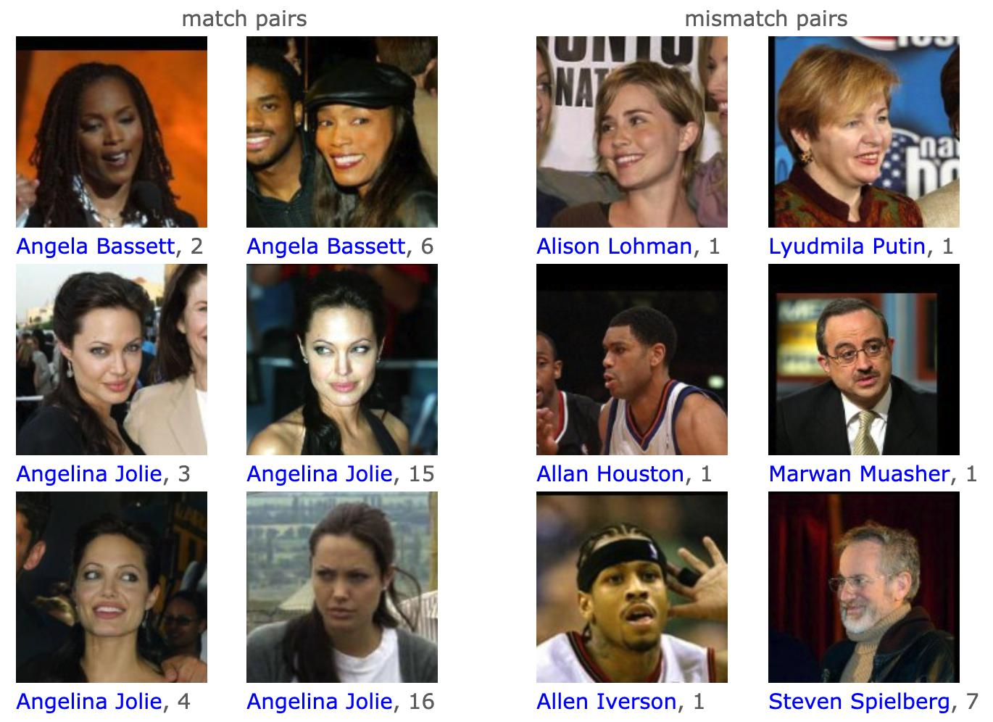
Related work
Face Recognition:
GhostNet: a lightweight and efficient model suitable for compact devices. It focuses on generating feature maps.
An accuracy of 99.8% on LFW dataset.
FaceNet: it employs a deep learning technique to transform face images into a condensed Euclidean space, creating distinct 'face embeddings' for each person.
An accuracy of 99.6% on LFW dataset.
[3]

Slide 12
Proposed design

Slide 13
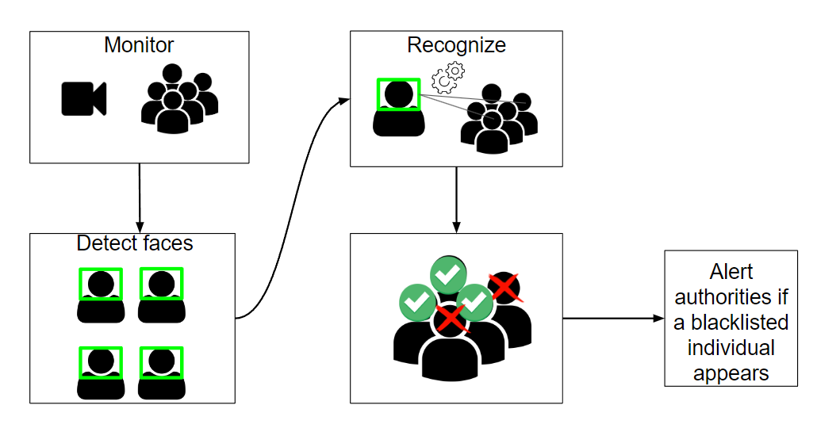
Proposed design
How our system will work

Slide 14
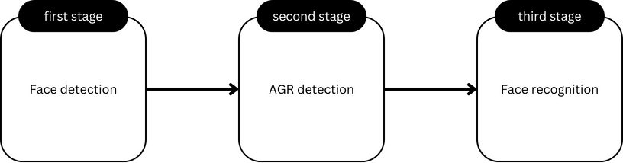
Proposed design
Our model will consist of 3 stages:
First stage is detecting all the faces inside the frame.
Second stage takes coordinates of first stage and computes age, gender and race.
Having an AGR detection layer will provide as with statistical data to used further on.
Third stage will recognize the faces detected from first stage.

Slide 15
Implementation

Slide 16



Implementation
Coding environment:
Google colab
Kaggle
Jupyter notebook
Python language

Slide 17
Implementation
Dataset:
Created my own dataset consisting of approximately 1700 images:
Consisting of images of me and online images as well.
Albumentation used for image augmentation.
Label me for image annotation.

Slide 18
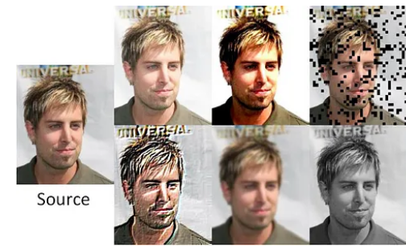
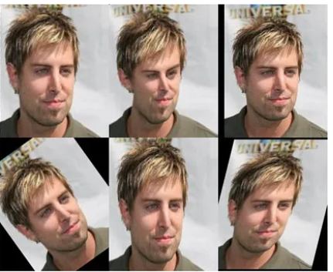
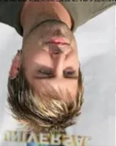
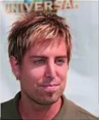
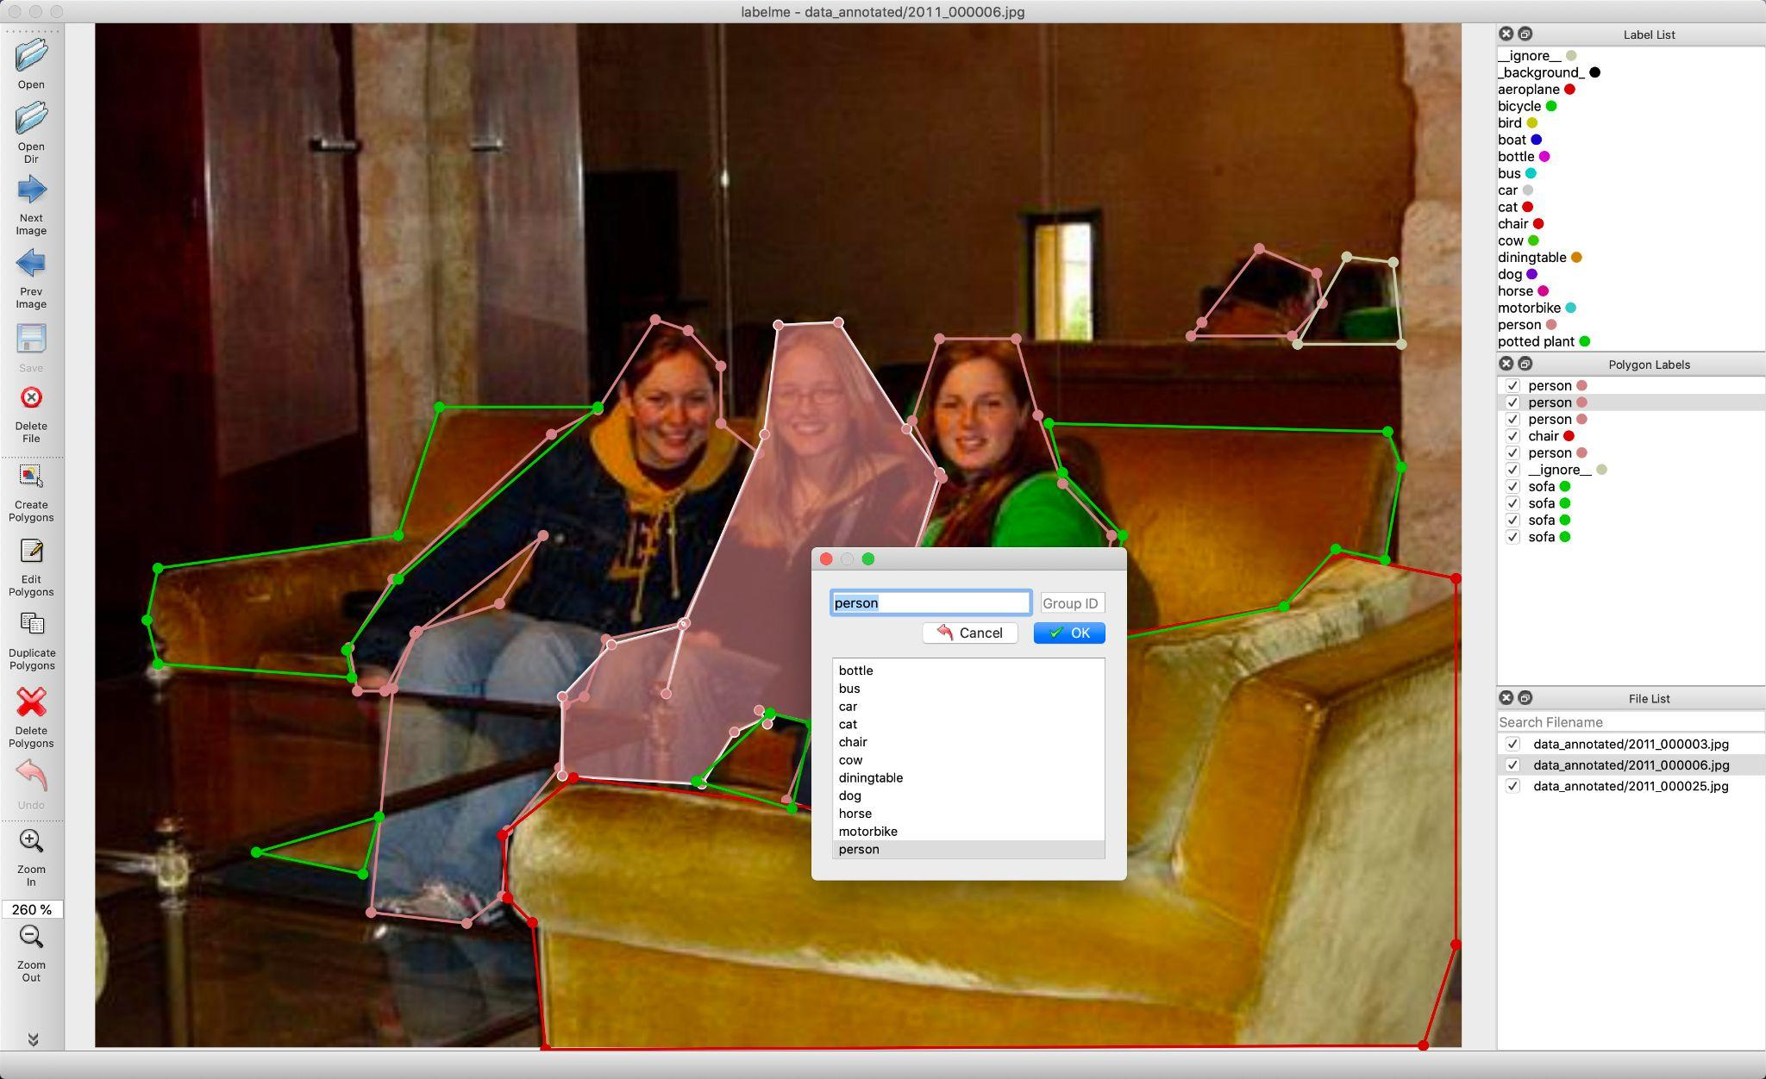
Implementation
[4]
Albumentation:
A python tool used for image augmentation.
Labelme:
A python tool used for image annotation.
[5]

Slide 19
Implementation
A.Face detection:
For face detection 3 different models were experimented with on different video surveillances:
ResNet: a pre-trained feature based face detection.
YOLOV9: you only look once version 9 trained on our custom dataset.
RetinaFace: pre-trained CNN model as discussed in the related work.

Slide 20
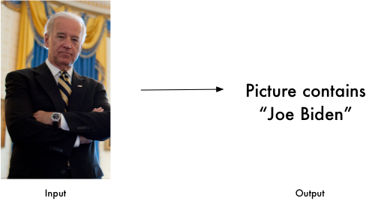
Implementation
B. AGR detection:
For age, gender and race(AGR) detection, pre-trained DeepFace model was used.
C.Face recognition:
For face recognition "face_recognition" library was used. It utilizes deep
learning techniques for feature based facial recognition in 3 steps:
Encode detected face.
Compare it with the database.
Return name of identified person.

Slide 21
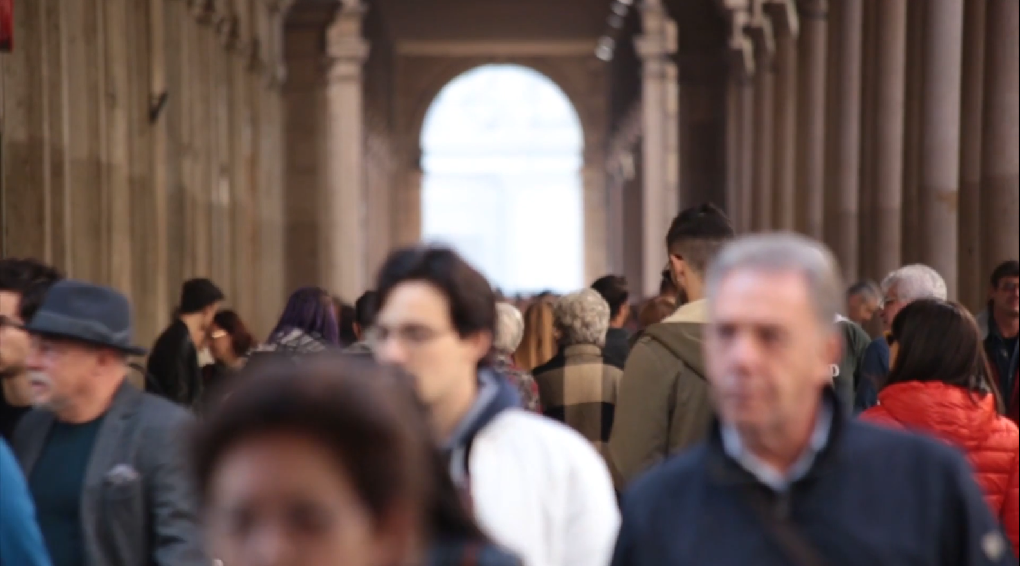
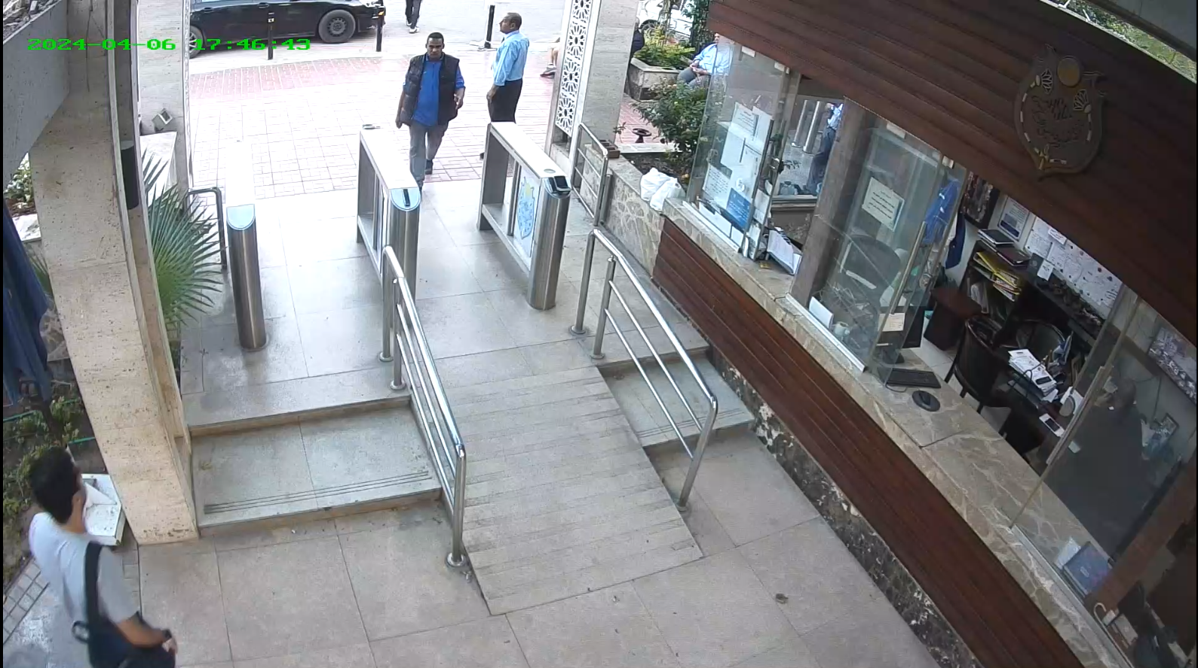
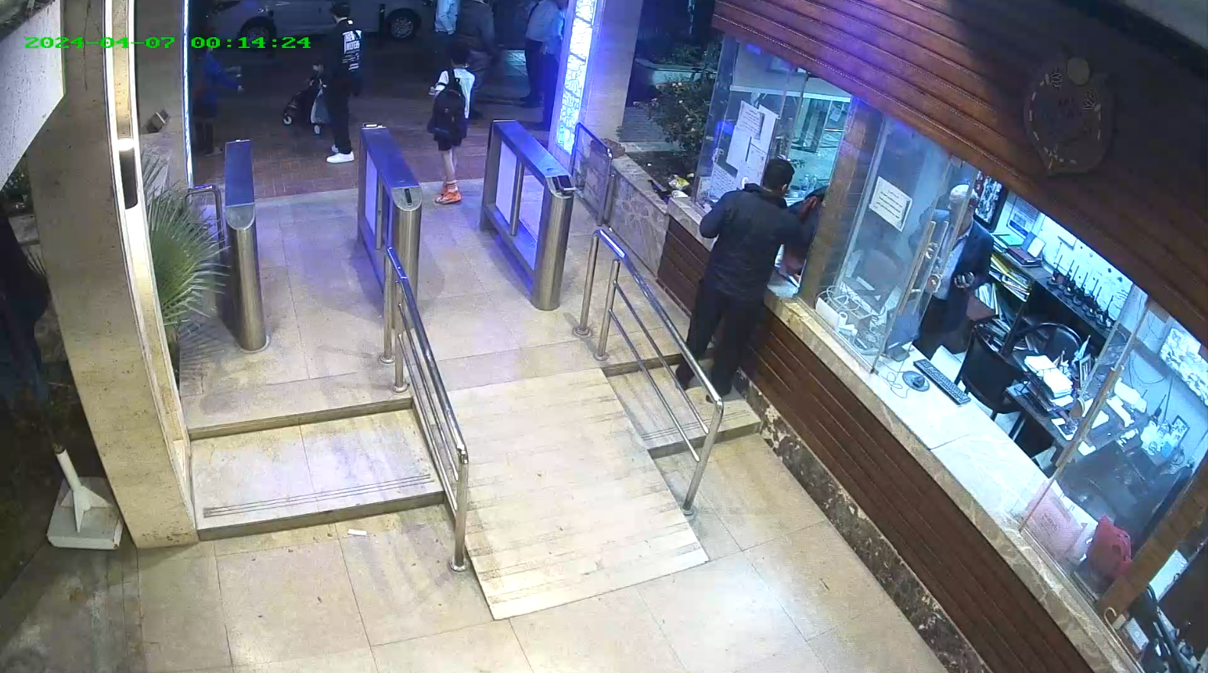
Implementation
The model created was tested on 3 video surveillances with different conditions.
Birds eye view
Eye level surveillance
20 seconds
Morning shift
9 minutes
Night shift
14 minutes

Slide 22
Results

Slide 23
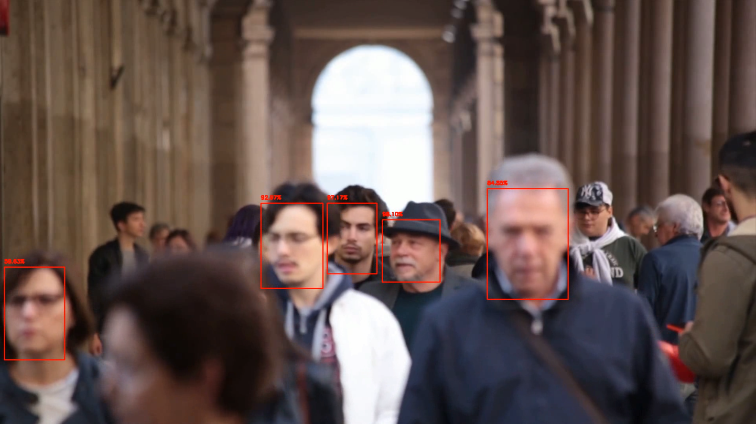
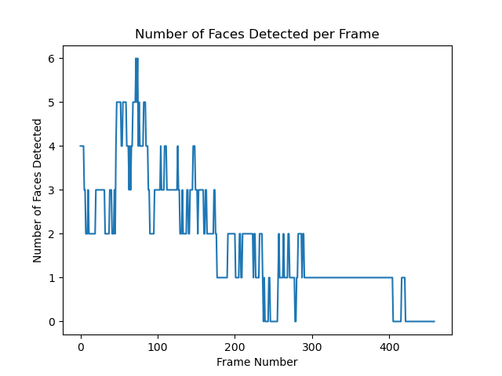
Results (face detection):
ResNet

Slide 24
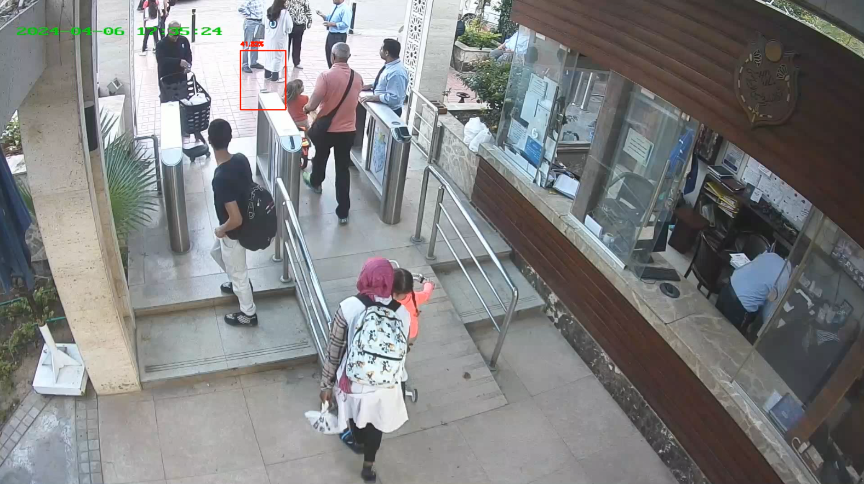
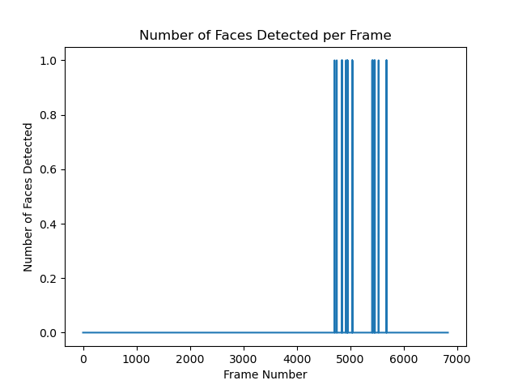
Results (face detection):
ResNet

Slide 25
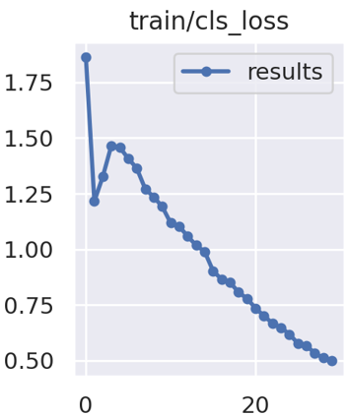
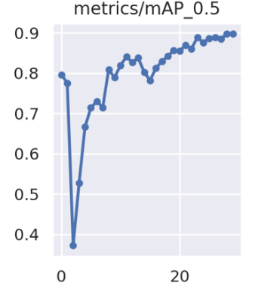
Results (face detection):
YOLOV9 training

Slide 26
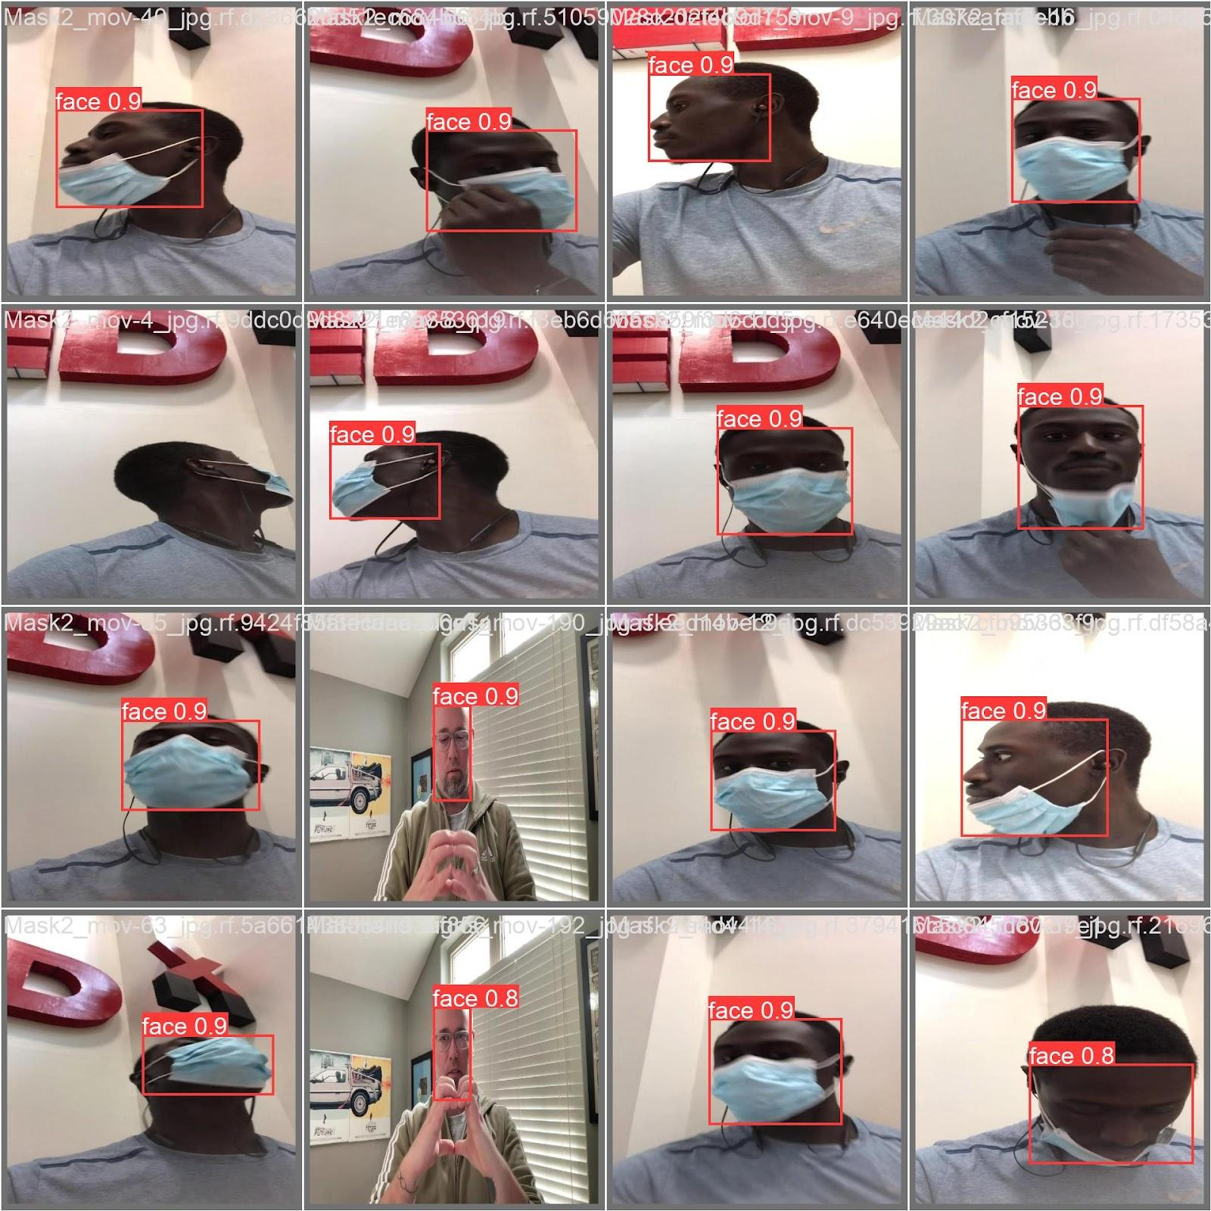
Results (face detection):
YOLOV9 training results:
A sample of validation results after model training.

Slide 27
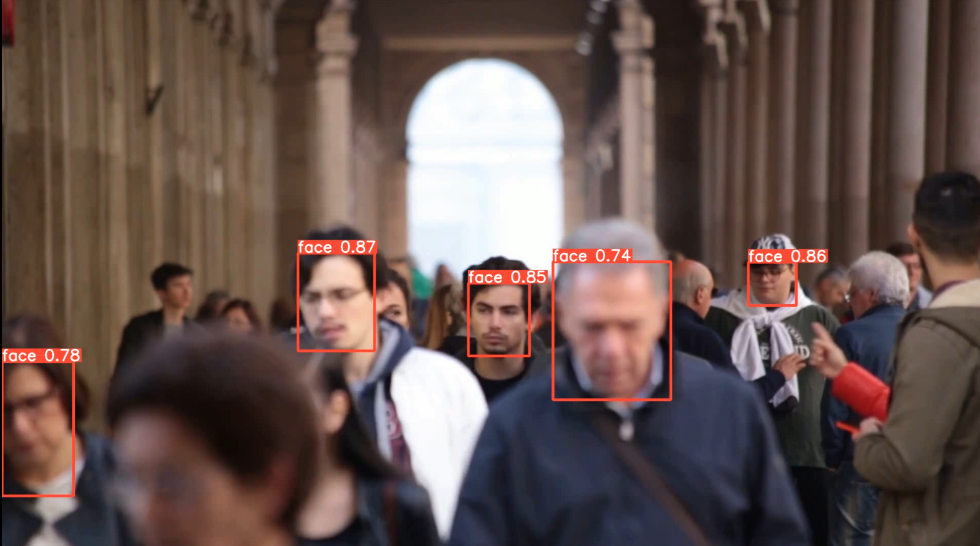
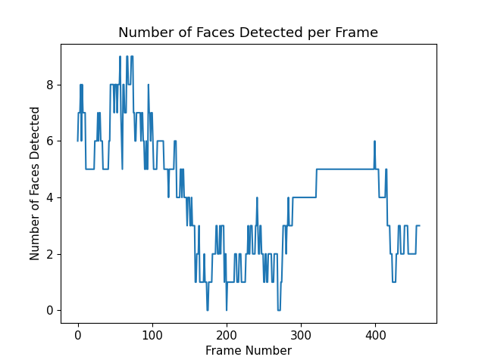
Results (face detection):
YOLOV9

Slide 28
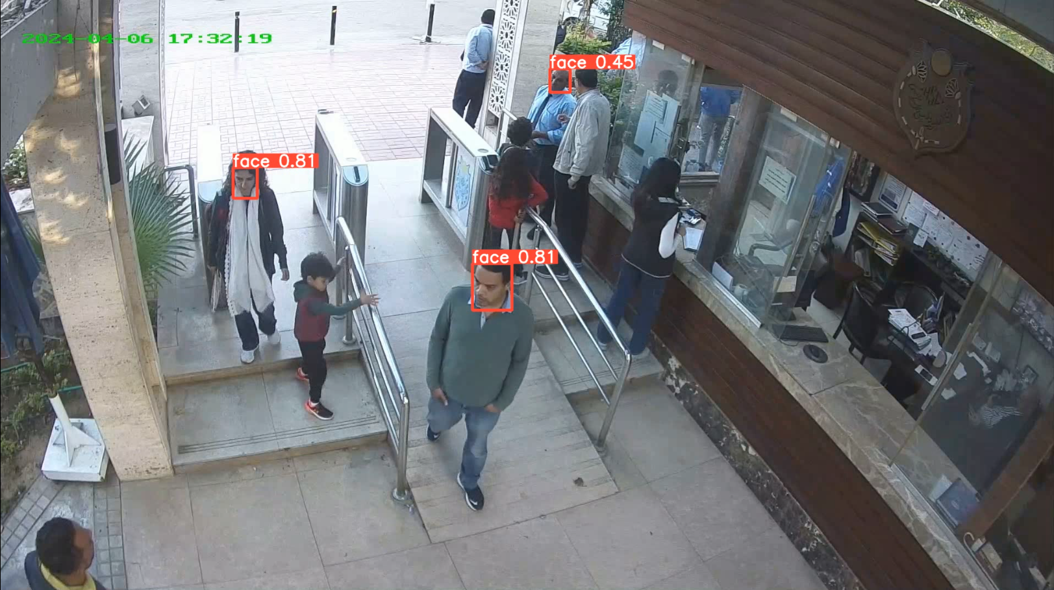
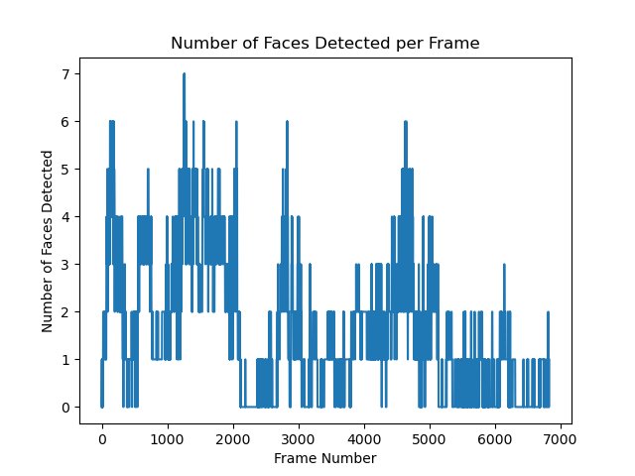
Results (face detection):
YOLOV9

Slide 29
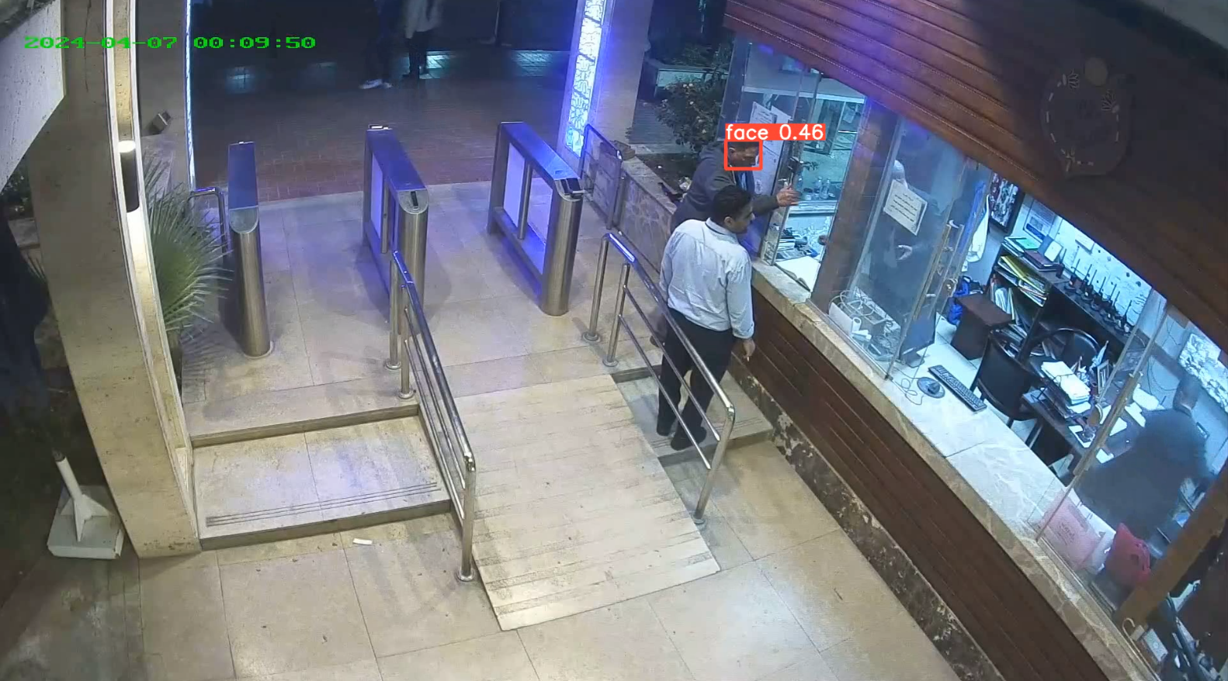
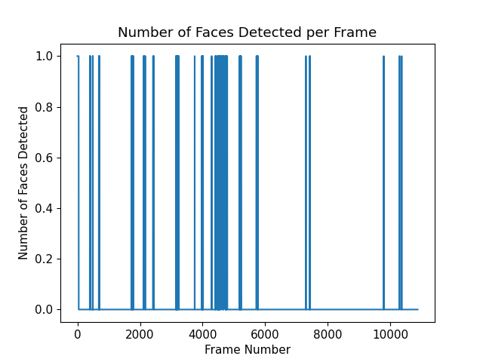
Results (face detection):
YOLOV9

Slide 30
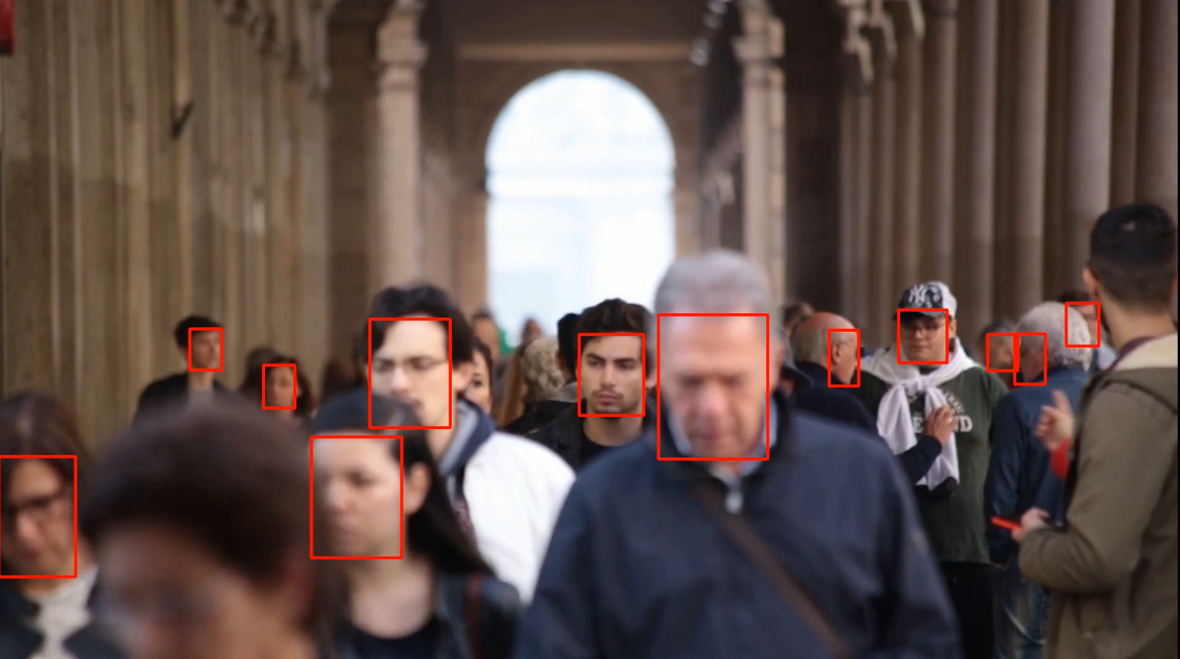
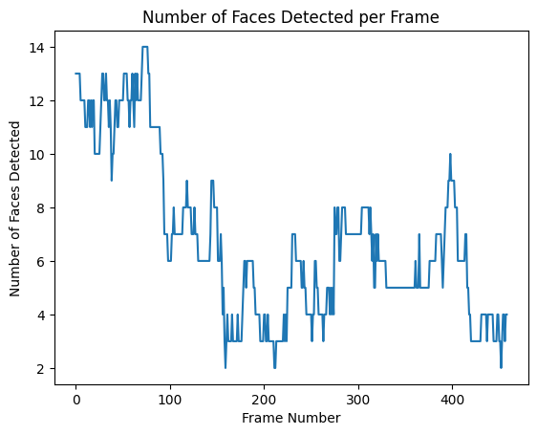
Results (face detection):
RetinaFace

Slide 31
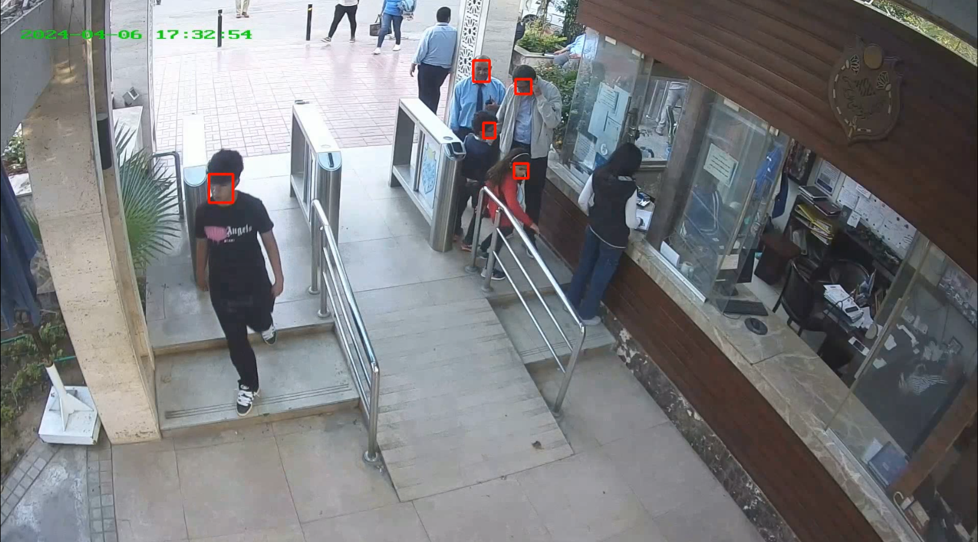
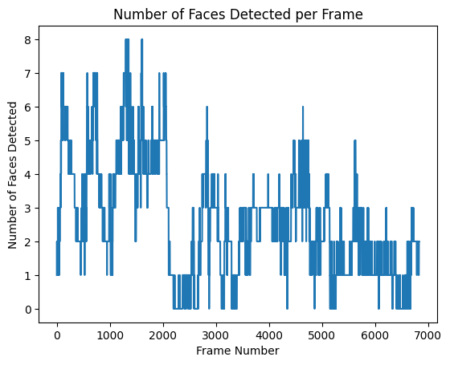
Results (face detection):
RetinaFace

Slide 32
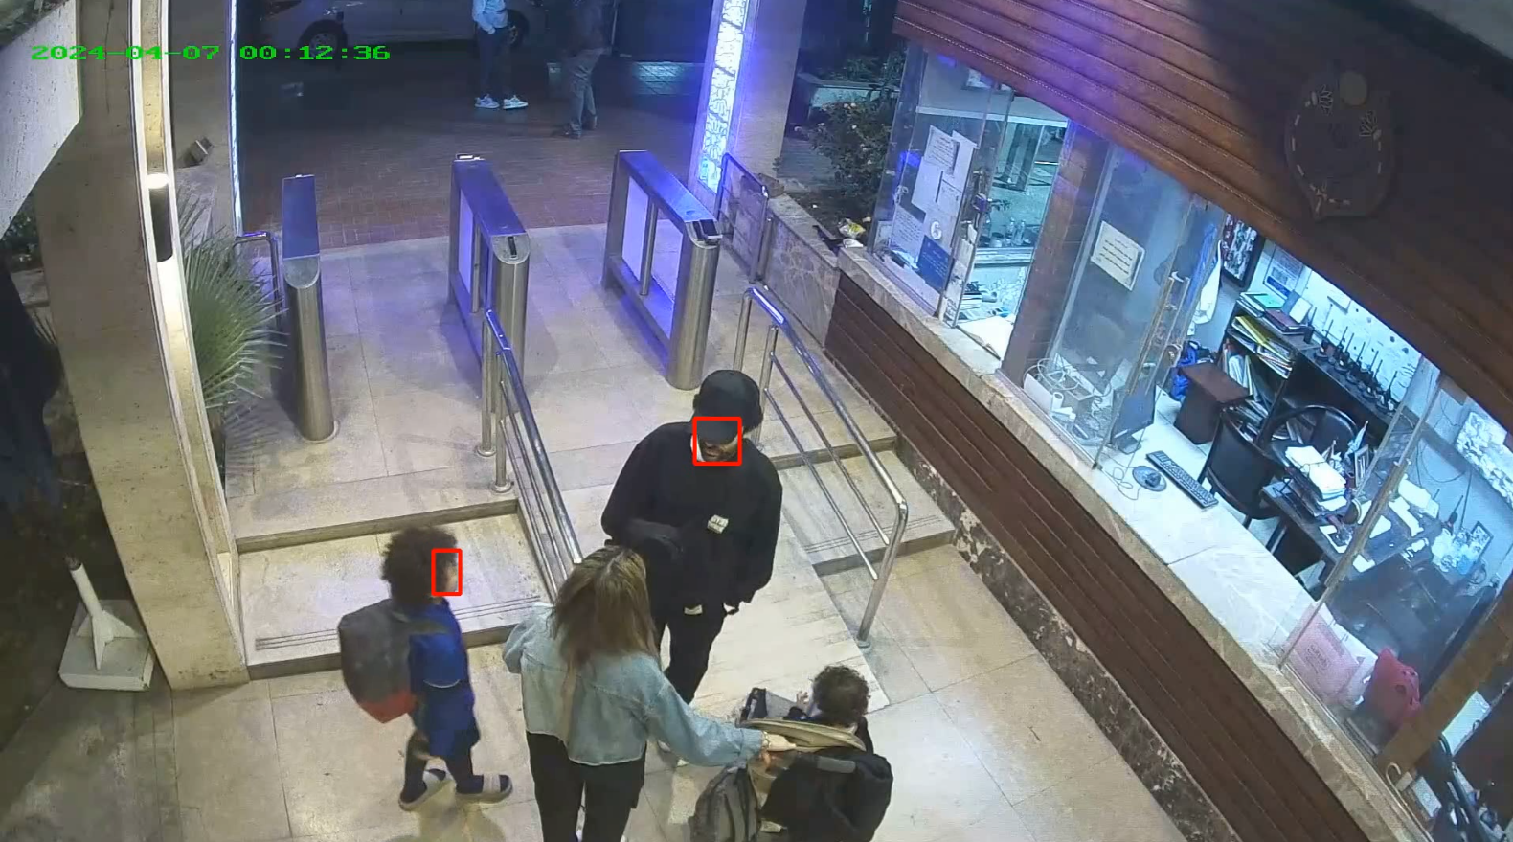
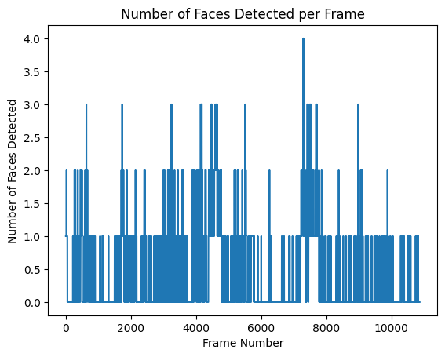
Results (face detection):
RetinaFace

Slide 33
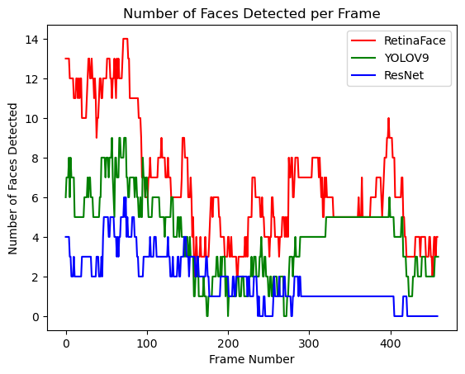
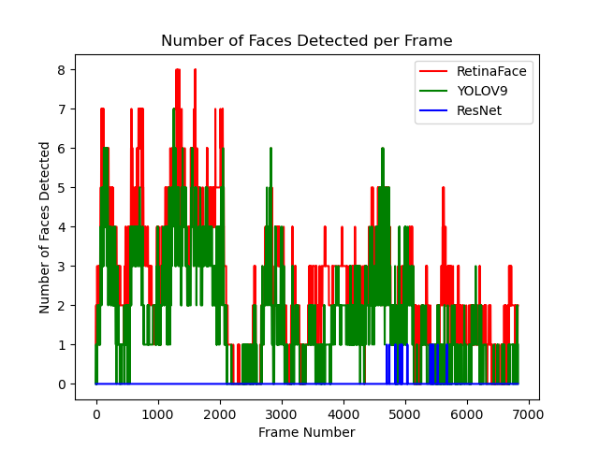
Results (face detection):
Eye level surveillance
Morning shift

Slide 34
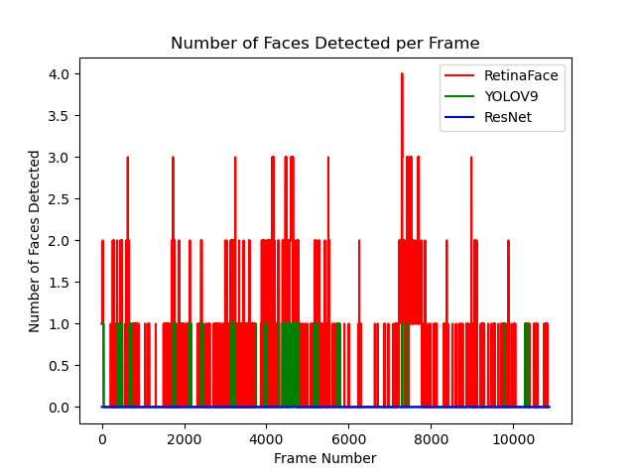
Results (face detection):
Night shift
Average precision
Video | Total frames | ResNet | YOLOV9 | RetinaFace
Eye level | 460 | 34.7% | 75% | 99.3%
Morning shift | 6832 | 0% | 62.8% | 98.1%
Night shift | 10871 | 0% | 12.5% | 93%

Slide 35
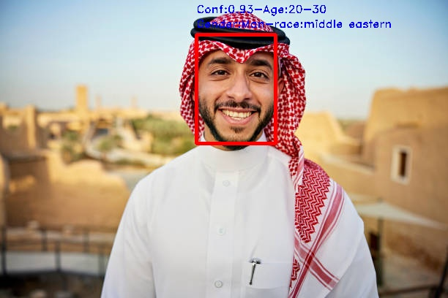
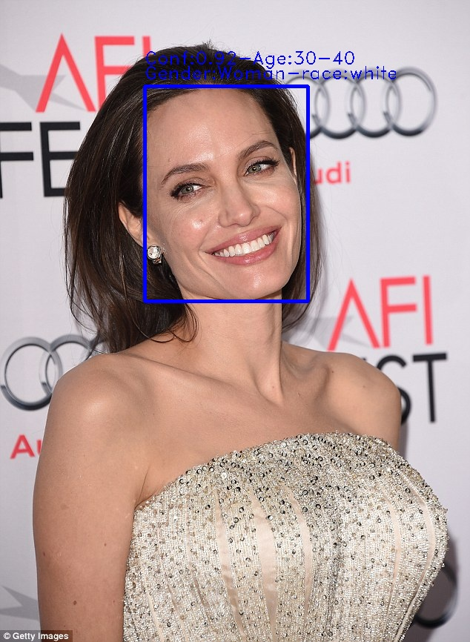
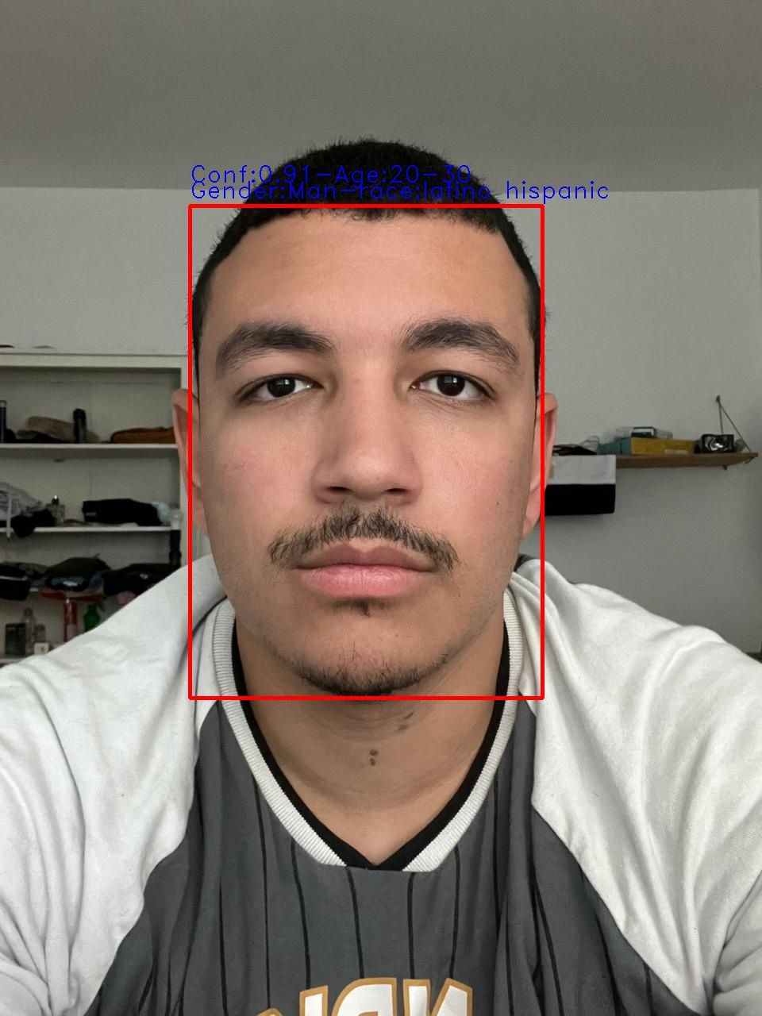
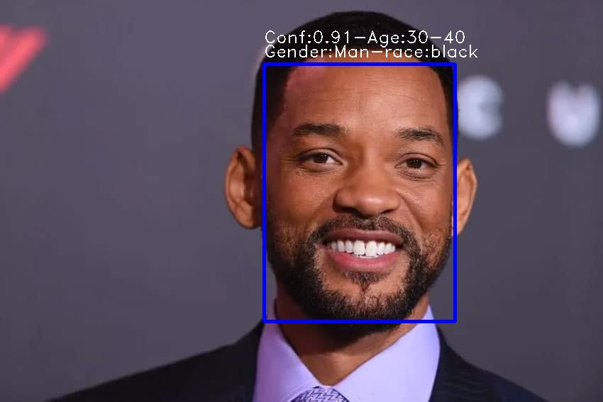
Result (AGR detection):
DeepFace detecting different races.

Slide 36
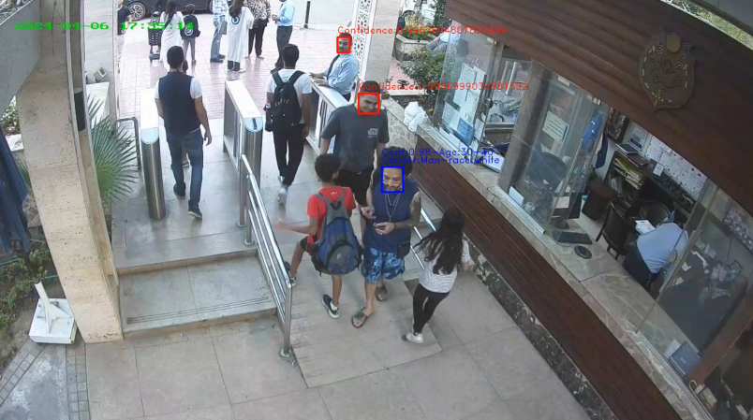
Result (AGR detection):
An accuracy of 97.4% on IMDB-WIKI dataset.
Similar issue to ResNet, facial features not clearly present.

Slide 37
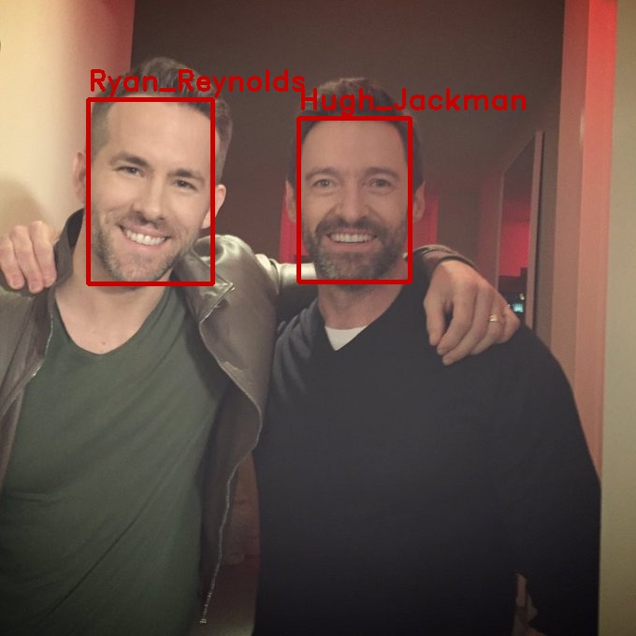
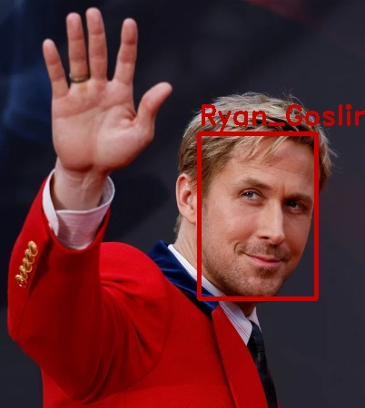
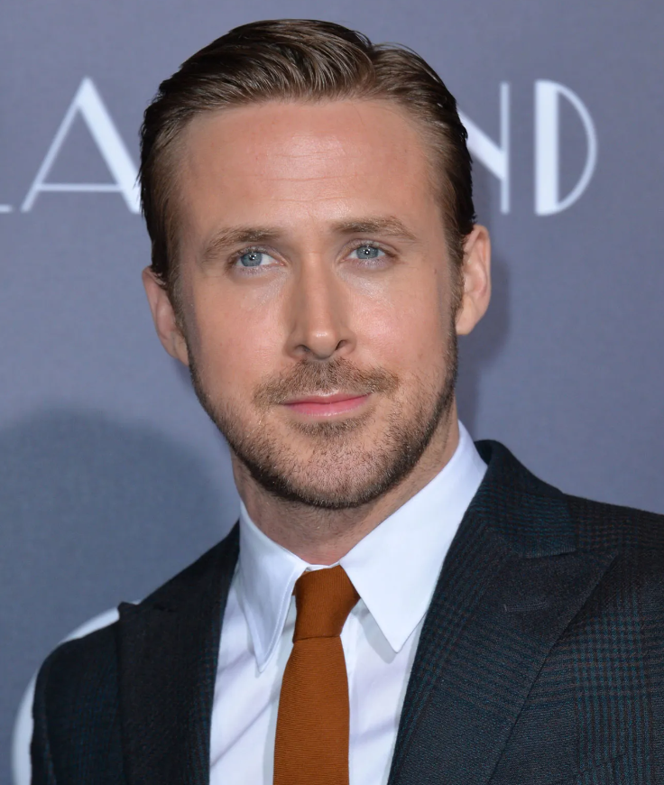
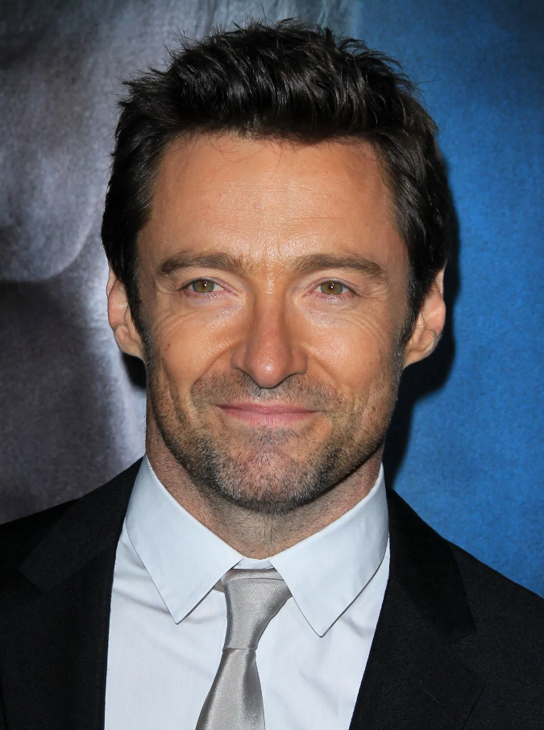
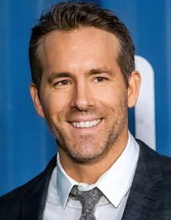
Result (face recognition):
Results
Pictures in the database

Slide 38

Result (face recognition):
An accuracy of 99.38% on LFW dataset
Similar issue to ResNet, facial features not clearly present.

Slide 39
Conclusion

Slide 40
Conclusion:
Each frame is passed through 3 stages face detection, AGR detection and face recognition.
RetinaFace was chosen for face detection for it high average precision than others.

Slide 41
Future work

Slide 42
Future Work:
Make model lightweight for compact devices.
Add emotion detection.
Train YOLOv9 on WIDER FACE dataset.
Further enhancements on face recognition to be able to recognise in video surveillance conditions.

Slide 43
References:
[1] Deng, J., Guo, J., Zhou, Y., Yu, J., Kotsia, I., & Zafeiriou, S. (2019). Retinaface: Single-stage dense face localisation in the wild. arXiv preprint arXiv:1905.00641.
[2] Li, J., Wang, Y., Wang, C., Tai, Y., Qian, J., Yang, J., ... & Huang, F. (2019). DSFD: dual shot face detector. In Proceedings of the IEEE/CVF conference on computer vision and pattern recognition (pp. 5060-5069).
[3] Gary B. Huang, Manu Ramesh, Tamara Berg, & Erik Learned-Miller (2007). Labeled Faces in the Wild: A Database for Studying Face Recognition in Unconstrained Environments [White paper]. University of Massachusetts, Amherst.
[4] Efficient Image Augmentation Library for Machine Learning. Albumentations. (n.d.). https://albumentations.ai/
[5] Labelmeai. (n.d.). Labelmeai/labelme: Image polygonal annotation with python (polygon, rectangle, circle, line, point and image-level flag annotation). GitHub. https://github.com/labelmeai/labelme

Slide 44
References:
[6] Ageitgey. (n.d.). Ageitgey/face_recognition: The world’s simplest facial recognition API for python and the command line. GitHub. https://github.com/ageitgey/face_recognition
[7] Serengil. (n.d.). Serengil/deepface: A lightweight face recognition and facial attribute analysis (age, gender, emotion and race) library for python. GitHub. https://github.com/serengil/deepface
[8] Alansari, M., Hay, O. A., Javed, S., Shoufan, A., Zweiri, Y., & Werghi, N. (2023). Ghostfacenets: Lightweight face recognition model from cheap operations. IEEE Access, 11, 35429-35446.
[9] Schroff, F., Kalenichenko, D., & Philbin, J. (2015). Facenet: A unified embedding for face recognition and clustering. In Proceedings of the IEEE conference on computer vision and pattern recognition (pp. 815-823).
[10] IMDB-wiki – 500K+ face images with age and gender labels. IMDB-WIKI - 500k+ face images with age and gender labels. (n.d.). https://data.vision.ee.ethz.ch/cvl/rrothe/imdb-wiki/

Slide 45
Thank you

Slide 46

Any Questions?

